Slide 1
Demand Paging

Slide 2
Demand paging
Problem:
Can a machines that contain 1 or 2 megabytes of physical memory execute processes whose sizes are 4 or 5 megabytes?
A process may not fit into physical memory, the kernel must load its relevant portions into memory dynamically and execute it even though other parts are not loaded.
Solution:
Demand paging systems
The kernel still imposes a limit on the virtual size of a process, dependent on the amount of virtual memory the machine can address.

Slide 3
Demand Paging
Locality
Processes tend to execute instructions in small portions of their text space, such as program loops and frequently called subroutines, and their data references tend to cluster in small subsets of the total data space of the process
Working set
Denning
The set of pages that the process has referenced in its last n memory references; the number n is called the window of the working set.

Slide 4
Working set
A fraction of the entire process,
More processes may fit simultaneously into main memory than in a swapping system, potentially increasing system throughput because of reduced swapping traffic.
When a process addresses a page that is not in its working set, it incurs a page fault;
To handle the fault, the kernel updates the working set, reading in pages from a secondary device if necessary

Slide 5
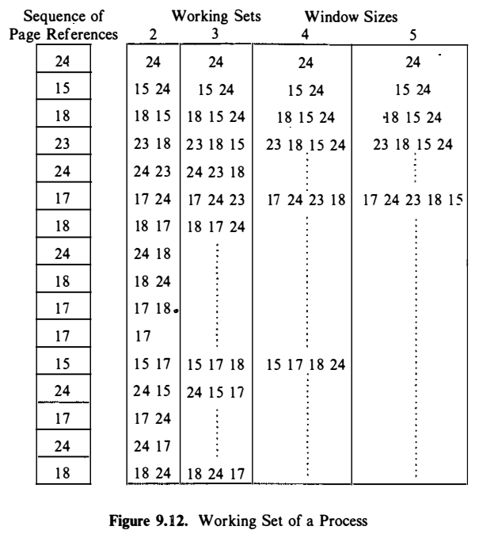
Working Window

Slide 6
Working set
Impractical to implement a pure working set model,
Expensive to remember the order of page references.
Instead, systems approximate a working set model by setting a reference bit and ages

Slide 7
Paging
Implementation of a paging subsystem has two parts:
Swapping rarely used pages to a swapping device and
Handling page faults.

Slide 8
Data Structures for Demand Paging
Four data structure
Page table entries,
Disk block descriptors
Page frame data table (called pfdata for short), and
Swap-use table
The kernel allocates space for the pfdata table once for the lifetime of the system but allocates memory pages for the other structures dynamically

Slide 9
Data Structures for Demand Paging
Region contains page tables to access physical memory
Each entry of a page table contains
The physical address of the page,
Protection bits indicating whether processes can read, write or execute from the page, and
The following bit fields to support demand paging:
Valid
Reference
Modify
Copy on write
Age

Slide 10
Data Structures for Demand Paging
Valid bit
The kernel turns on the valid bit to indicate that the contents of a page are legal, but the page reference is not necessarily illegal if the valid bit is off.
Reference bit
Whether a process recently referenced a page,
Modify bit
Whether a process recently modified the contents of a page.
Copy on write bit,
used in the fork system call,
Indicates that the kernel must create a new copy of the page when a process modifies its contents.
Age bits
kernel manipulates the age bits to indicate how long a page has been a member of the working set of a process.

Slide 11
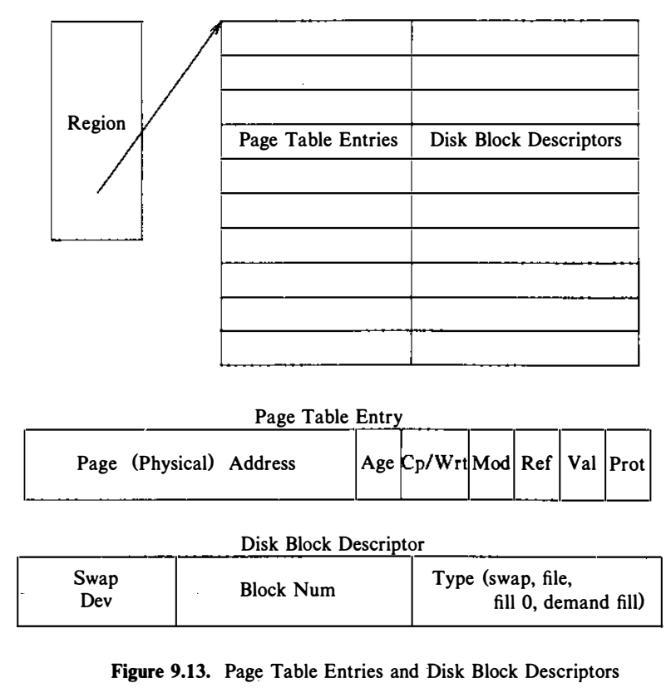
Data Structures for Demand Paging
Each page table entry is associated with a disk block descriptor, which describes the disk copy of the virtual page.
Processes that share a region therefore access common page table entries and disk block descriptors.
The contents of a virtual page are either in a particular block on a swap device, in an executable file, or not on a swap device.
If the page is on a swap device, the disk block descriptor contains the logical device number and block number containing the page contents.
If the page is contained in an executable file, the disk block descriptor contains the logical block number in the file that contains the page; the kernel can quickly map this number into its disk address.

Slide 12
Data Structures for Demand Paging
The pfdata table describes each page of physical memory and is indexed by page number. The fields of an entry are
The page state, indicating that the page is on a swap device or executable file
The number of processes that reference the page.
The reference count equals the number of valid page table entries that reference the page.
It may differ from the number of processes that share regions containing the page.
The logical device (swap or file system) and block number that contains a copy of the page.
Pointers to other pfdata table entries on a list of free pages and on a hash queue of pages.

Slide 13
Data Structures for Demand Paging
The kernel links entries of the pfdata table onto a free list and a hashed list.
Free list
A cache of pages that are available for reassignment,
A process may fault on an address and still find the corresponding page intact on the free-list.
The free list thus allows the kernel to avoid unnecessary read operations from the swap device.
The kernel allocates new pages from the list in least recently used order.
The kernel also hashes the pfdata table entry according to its (swap) device number and block number.
To assign a physical page to a region, the kernel removes a free page frame entry from the head of the free list, updates its swap device and block numbers, and puts it onto the correct hash queue.

Slide 14
Data Structures for Demand Paging
The swap-use table contains an entry for every page on a swap device.
The entry consists of a reference count of how many page table entries point to a page on a swap device.

Slide 15
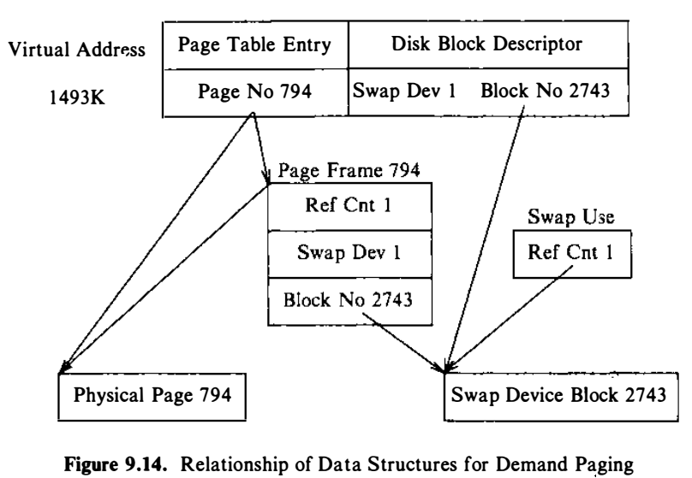
Data Structures for Demand Paging
Virtual address 1493K of a process maps into a page table entry that points to physical page 794
The disk block descriptor for the page table entry shows that a copy of the page exists at disk block 2743 on swap device 1
The pfdata table entry for physical page 794 also shows that a copy of the page exists at disk block 2743 on swap device 1, and its in-core reference count is 1
The swap use count . for the virtual page is 1, meaning that one page table entry points to the swap copy

Slide 16
Fork in a Paging System
The kernel duplicates every region of the parent process during the fork system call and attaches it to the child process.
The kernel avoids copying the page by manipulating the region tables, page, table entries, and pfdata table entries.
Increments the region reference count of shared regions
For private regions such as data and stack, allocates a new region table entry and page table
Examine each parent page table entry,
If a page is valid, increments the reference count in the pfdata table entry, indicating the number of processes that share the page via different regions
If the page exists on a swap device, it increments the swap-use table reference count for the page

Slide 17
Fork in a Paging System
If a process writes on a shared page
The kernel copies the page so that each region has a private version.
To do this, the kernel turns on the "copy on write" bit for every page table entry in private regions of the parent and child processes during fork
If either process writes the page, it incurs a protection fault,
In handling the fault, the kernel makes a new copy of the page for the faulting process.
The physical copying of the page is thus deferred until a process really needs it

Slide 18
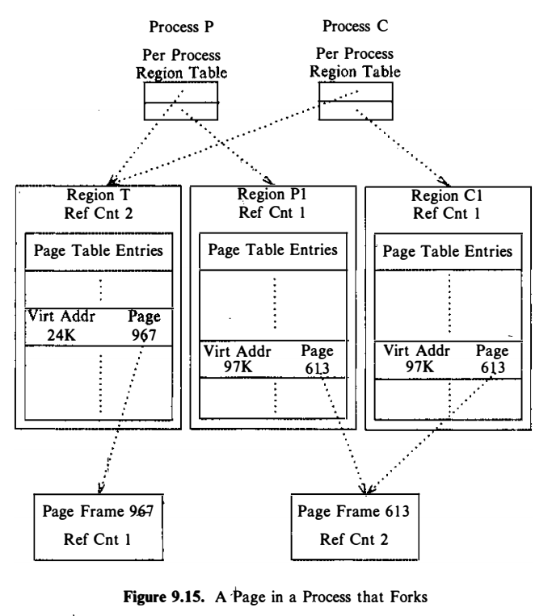
Fork in a Paging System
Copy of P1

Slide 19
Exec in a Paging System
The kernel reads the executable file into memory from the file system
On a demand paged system,
The executable file may be too large to fit in the available main memory.
The kernel, therefore, does not preassign memory to the executable file but "faults" it in, assigning memory as needed.
It first assigns the page tables and disk block descriptors for the executable file, marking the page table entries "demand fill" (for non-bss data) or "demand zero" (for bss data)

Slide 20
Exec in a Paging System
The fault handler notes whether the page is
“demand fill ”: its contents will immediately be overwritten with the contents of the, executable file so it need not be cleared,
“demand zero”: its contents should be cleared.
If the process cannot fit into memory, the page-stealer process periodically swaps pages from memory, making room for the incoming file.

Slide 21
Exec in a Paging System
Inefficiencies:
First, a process incurs a page fault when reading each page of the executable file, even though it may never access the page.
Second, the page stealer may swap pages from memory before the exec is done, resulting in two extra swap operations per page if the process needs the page early.
To make exec more efficient, the kernel can demand page directly from the executable file if the data is properly aligned, as indicated by a special magic number.

Slide 22
The Page-Stealer Process
A kernel process
Swaps out memory pages that are no longer part of the working set of a process.
The kernel creates during system initialization and invokes it throughout the lifetime of the system when low on free pages.
Examines every active, unlocked region, skipping locked regions in the expectation of examining them during its next pass through the region list, and increments the age field of all valid pages.
The kernel locks a region when a process faults on a page in the region, so that the page stealer cannot steal the page being faulted in.

Slide 23
The Page-Stealer Process
Two paging states
The page is aging and is not yet eligible for swapping, or
The page is eligible for swapping and is available for reassignment to other virtual pages.
The first state indicates that a process recently accessed the page, and the page is therefore in its working set.
Reference bit

Slide 24
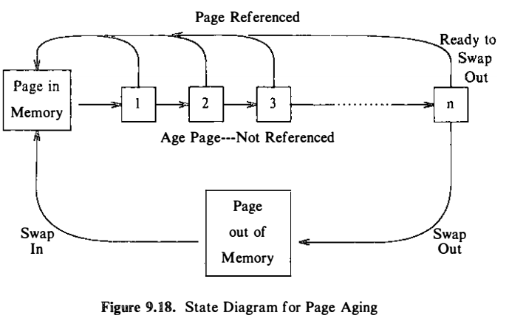
The Page-Stealer Process
The page stealer turns off the reference bit for such pages but remembers how many examinations have passed since the page was last referenced.
When the number exceeds a threshold value, the kernel puts the page into the second state, ready to be swapped.
The maximum period that a page can age before it is eligible to be swapped is implementation dependent,

Slide 25
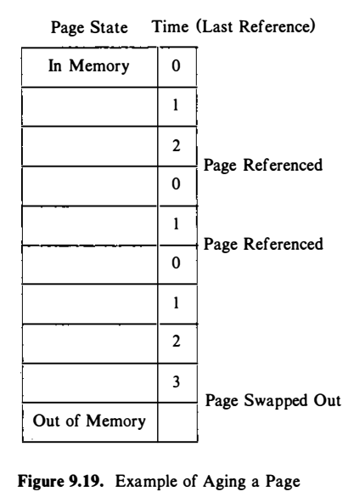
The Page-Stealer Process
The interaction between processes accessing a page and examinations by the page stealer

Slide 26
The Page-Stealer Process
Two or more processes share a region ?
Processes update the reference bits of the same set of page table entries.
Pages can be part of the working set of more than one process
If a page is part of the working set of any process, it remains in memory;
If it is not part of the working set of any process, it is eligible for swapping.
The page stealer does not attempt to swap out equal numbers of pages from all active regions.

Slide 27
The Page-Stealer Process
Kernel wakes up the page stealer when the available free memory in the system is below a low-water mark
Swaps out pages until the available free memory in the system exceeds a high-water mark
Why low- and high-water mark??
To reduces thrashing

Slide 28
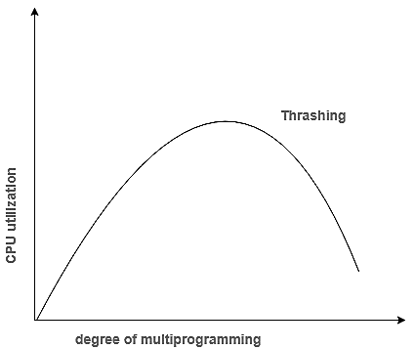
The Page-Stealer Process
Thrashing
A condition or a situation when the system is spending a major portion of its time in servicing the page faults, but the actual processing done is very negligible.

Slide 29
The Page-Stealer Process
Three cases when the page stealer decides to swap out a page, it considers whether a copy of the page is on a swap device:
If no copy of the page is on a swap device
If a copy of the page is already on a swap device and no process had modified its in-core contents
If a copy of the page is on a swap device but a process had modified its contents in memory

Slide 30
The Page-Stealer Process
The page stealer fills a list of pages to be swapped, possibly from different regions, and swaps them to a swap device when the list is full.
There is more fragmentation of a swap device in the paging scheme than in a swapping scheme, why?
The kernel swaps out blocks of pages but swaps in only one page at a time

Slide 31
The Page-Stealer Process
When the kernel writes a page to a swap device,
It turns off the valid bit in its page table entry
Decrements the use count of its pfdata table entry.
If the count drops to 0, it places the pfdata table entry at the end of the free list, caching it until reassignment.
If the count is not 0, several processes are sharing the page as a result of a previous fork call, but the kernel still swaps the page out.
Finally, the kernel allocates swap space, saves the swap address in the disk block descriptor, and increments the swap-use ta

Slide 32
The Page-Stealer Process
When the kernel writes a page to a swap device,
It turns off the valid bit in its page table entry
Decrements the use count of its pfdata table entry.
If the count drops to 0, it places the pfdata table entry at the end of the free list, caching it until reassignment.
If the count is not 0, several processes are sharing the page, but the kernel still swaps the page out.
Finally, the kernel allocates swap space, saves the swap address in the disk block descriptor, and increments the swap-use table count for the page.
If a process incurs a page fault while the page is on the free list, however, the kernel can rescue the page from memory instead of having to retrieve it from the swap device.

Slide 33
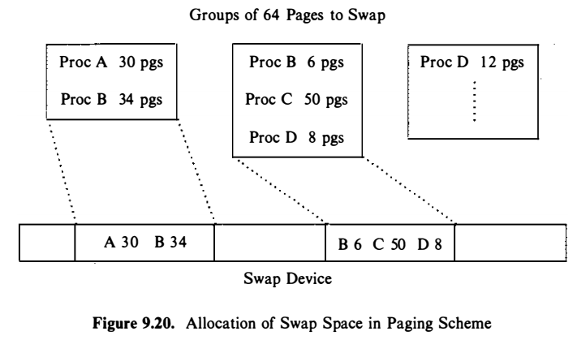
The Page-Stealer Process
Suppose the page stealer swaps out 30, 40, 50 and 20 pages from processes A, B, C, and D, respectively
The page stealer keeps the remaining 1 2 pages of process D on the list of pages to be swapped but does not swap them until the list is full.

Slide 34
The Page-Stealer Process: Summary
There are two phases to swapping a page from memory:
First, the page stealer finds the page eligible for swapping and places the page number on a list of pages to be swapped
Second, the kernel copies the page to a swap device,
Turns off the valid bit in the page table entry,
Decrements the pfdata table entry reference count, and
Places the pfdata table entry at the end of the free list if its reference count is 0.
The contents of the physical page in memory are valid until the page is reassigned

Slide 35
Page Faults
Types of page faults:
Validity faults and
Protection faults
The fault handlers may have to read a page from disk to memory and sleep during the I/O operation, fault handlers are an exception to the general rule that interrupt handlers cannot sleep.

Slide 36
Validity Fault Handler
When Validity Fault Handler will be invoked?
If a process attempts to access a page whose valid bit is not set
When valid bit is not set?
For pages outside the virtual address space of a process,
For pages that are part of the virtual address space but do not currently have a physical page assigned to them.
The hardware supplies the kernel with the virtual address that was accessed to cause the memory fault, and the kernel finds the page table entry and disk block descriptor for the page.

Slide 37
Validity Fault Handler
The kernel locks the region containing the page table entry
To prevent race conditions that would occur if the page stealer attempted to swap the page out.
If the disk block descriptor has no record of the faulted page,
The attempted memory reference is invalid
The kernel sends a "segmentation violation" signal to the offending process

Slide 38
Validity Fault Handler
The page that caused the fault is in one of five states:
On a swap device and not in memory,
On the free page list in memory,
In an executable file,
Marked "demand zero,"
Marked "demand fill"

Slide 39
Validity Fault Handler
CASE 1: On a swap device and not in memory
It once resided in the main memory but the page stealer had swapped it out.
From the disk block descriptor, the kernel finds the swap device and block number where the page is stored
The kernel Verifies that the page is not in the page cache (pfdata Table).
The kernel updates the page table entry so that it points to the page about to be read in, places the pfdata table entry on a hash list to speed later operation of the fault handler, and reads the page from the swap device.
The faulting process sleeps until the I/O completes, when the kernel awakens other processes who were waiting for the contents of the page to be read in.

Slide 40
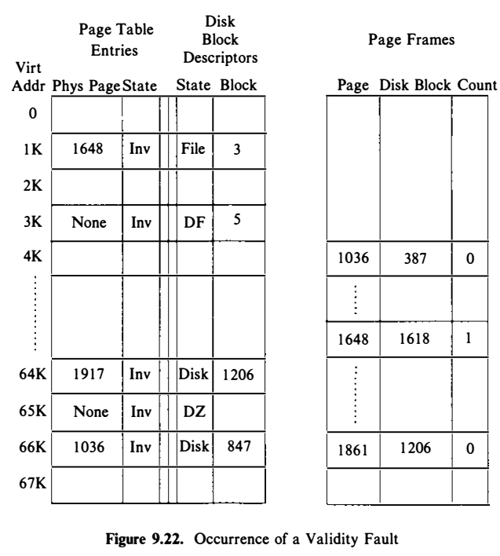
Validity Fault Handler
Consider the page table entry for virtual address 66K in Figure.
If a process incurs a validity fault when accessing the page
The fault handler examines the disk block descriptor and sees that the page is contained in block 847 of the swap device (assume there is only one swap device): Hence, the virtual address is legal.
The fault handler then searches the page cache but fails to find an entry for disk block 847.
Therefore, there is no copy of the virtual page in memory, and the fault handler must read it from the swap device.

Slide 41
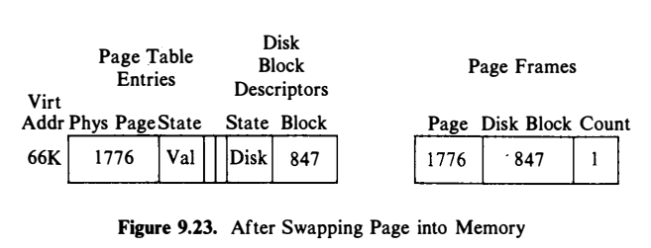
Validity Fault Handler
The kernel assigns page 1776 (Figure 9.23) , reads the contents of the virtual page from the swap device into the new page, and updates the page table entry to refer to page 1776.
Finally, it updates the disk block descriptor to indicate that the page is still swapped and the pfdata table entry for page 1776 to indicate that block 847 of the swap device contains a duplicate copy of the virtual page.

Slide 42
Validity Fault Handler
Case II: on the free page list in memory
It is possible that the kernel had never reassigned the physical page after swapping it out, or that another process had faulted the virtual page into another physical page.
In either case, the fault handler finds the page in the page cache, keying off the block number in the disk block descriptor.
It reassigns the page table entry to point to the page just found, increments its page reference count, and removes the page from the free list

Slide 43
Validity Fault Handler
A process faults when accessing virtual address 64K in Figure.
Searching the page cache, the kernel finds that page frame 1861 is associated with disk block 1206, as is the disk block descriptor.
It resets the page table entry for virtual address 64K to point to page 1861, sets the valid bit, and returns.
1861
V

Slide 44
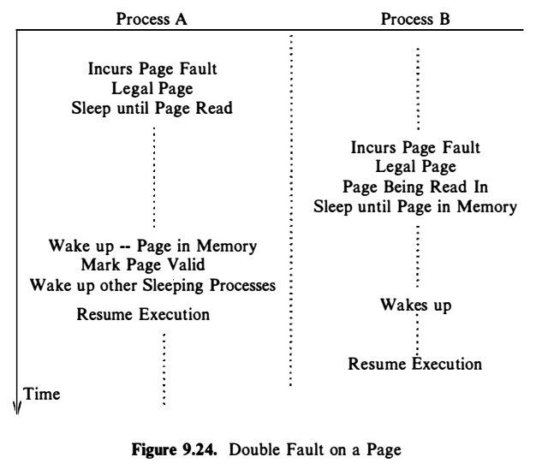
Validity Fault Handler
The fault handler does not have to read the page into memory if another process had faulted on the same page but had not completely read it in yet.
The fault handler finds the region containing the page table entry locked by another instance of the fault handler.
It sleeps until the other instance of the fault handler completes, finds the page now valid, and returns.

Slide 45
Validity Fault Handler
CASE III: a copy of the page does not exist on a swap device but is in the original executable file
The fault handler examines the disk block descriptor
Finds the logical block number in the file that contains the page, and finds the inode associated with the region table entry.
It uses the logical block number as an offset into the array of disk block numbers attached to the inode during exec.
Knowing the disk block number, it reads the page into memory.

Slide 46
Validity Fault Handler
The disk block descriptor for virtual address 1K in Figure
The page contents are in logical block 3 in the executable file

Slide 47
Validity Fault Handler
CASE IV and V: a process incurs a page fault for a page marked "demand fill" or "demand zero"
The kernel allocates a free page in memory and updates the appropriate page table entry.
For "demand zero," it also clears the page to zero.
Finally, it clears the "demand fill" or "demand zero" flags
The page is now valid in memory and its contents are not duplicated on a swap device or in a file system.
This would happen when accessing virtual addresses 3K and 65K in Figure

Slide 48
Validity Fault Handler
The validity fault handler concludes
Setting the valid bit of the page
Clearing the modify bit
Recalculates the process priority, because the process may have slept in the fault handler at a kernel-level priority, giving it an unfair scheduling advantage when returning to user mode
Finally, if returning to user mode, it checks for receipt of any signals that occurred while handling the page fault

Slide 49
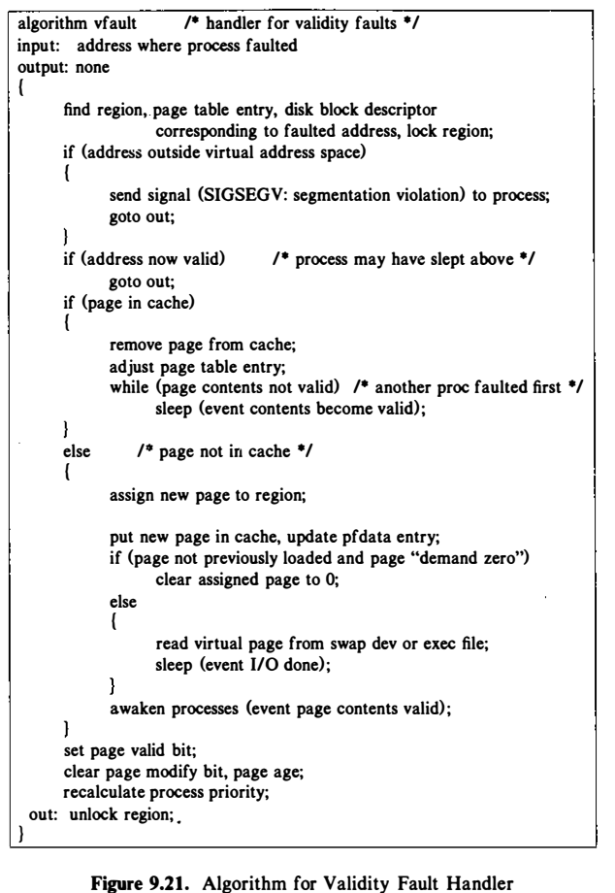
Validity Fault Handler

Slide 50
Protection Fault Handler
A process can incur is a protection fault:
The process accessed a valid page but the permission bits associated with the page did not permit access.
When it attempts to write a page whose copy on write bit was set during the fork system call.

Slide 51
Protection Fault Handler
The hardware supplies the protection fault handler with the virtual address where the fault occurred,
The fault handler finds the appropriate region and page table entry.
It locks the region
The page stealer cannot steal the page while the protection fault handler operates on it.

Slide 52
Protection Fault Handler
If the fault handler determines: copy on write bit was set
If the page is shared with other processes,
The kernel allocates a new page
Copies the contents of the old page to it;
The other processes retain their references to the old page.
After copying the page and updating the page table entry with the new page number,
The kernel decrements the reference count of the old pfdata table entry.

Slide 53
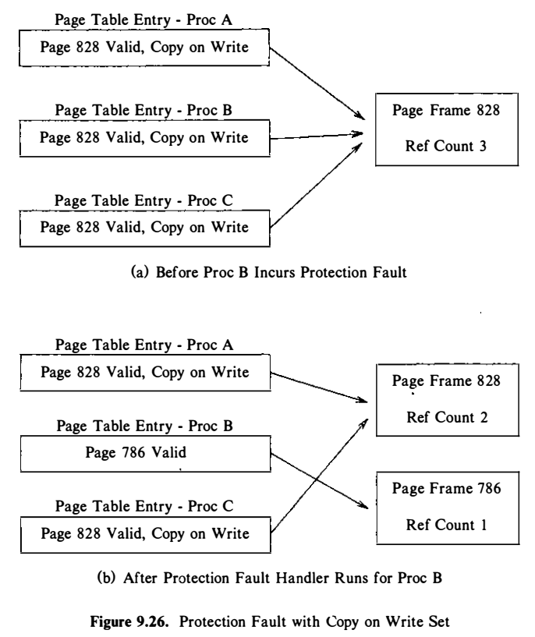
Protection Fault Handler
Three processes share physical page 828
Process B writes the page but incurs a protection fault, because the copy on write bit is set
The protection fault handler allocates page 786, copies the contents of page 828 to the new page, decrements the reference count of page 828, and updates the page table entry accessed by process B to point to page 786.

Slide 54
Protection Fault Handler
If the copy on write bit is set but no other processes share the page, the kernel allows the process to reuse the physical page.
It turns off the copy on write bit
Disassociates the page from its disk copy, if one exists,
because other processes may share the disk copy.
It then removes the pfdata table entry from the page queue, because the new copy of the virtual page is not on the swap device.
Decrements the swap-use count for the page and, if the count drops to 0, frees the swap space

Slide 55
Protection Fault Handler
If a page table entry is invalid and its copy on write bit is set
Assume that the system handles the validity fault first when a process accesses the page
The protection fault handler must check that a page is still valid, because it could sleep when locking a region, and the page stealer could meanwhile swap the page from memory.
If the page is invalid (the valid bit is clear), the fault handler returns immediately, and the process will incur a validity fault.

Slide 56
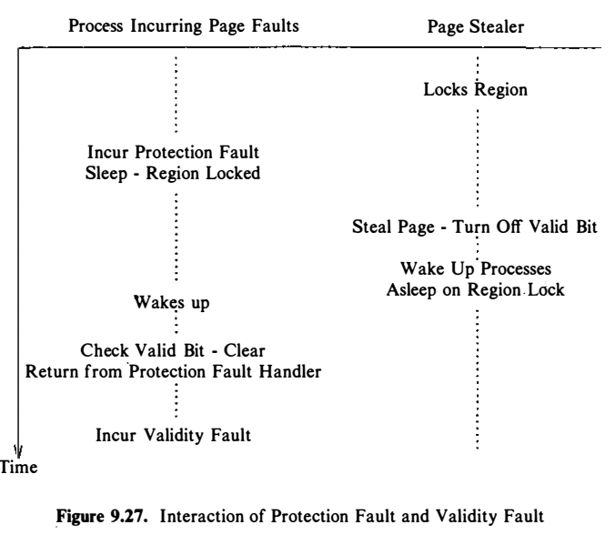
Protection Fault Handler
The kernel handles the validity fault, but the process will incur the protection fault again. More than likely, it will handle the final protection fault without any more interference, because it will take a long time until the page will age sufficiently to be swapped out.
When the protection fault handler finishes executing,
It sets the modify and protection bits,
Clears the copy on write bit.
Recalculates the process priority and checks for signals

Slide 57
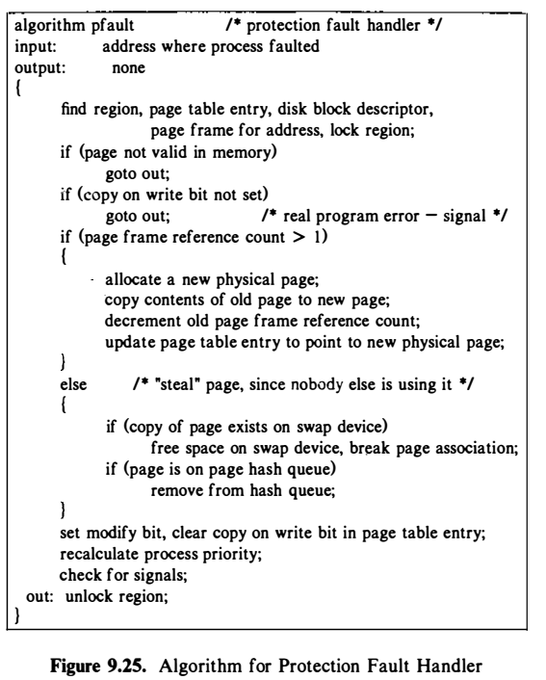
Protection Fault Handler

Slide 58
Demand Paging on Less-Sophisticated Hardware
It is possible to implement the paging algorithms described here if the hardware recognizes only the valid and protection bits.
If the valid bit is duplicated by a software-valid bit that indicates whether the page is really valid or not, then the kernel could turn off the hardware valid bit and simulate the setting of the other bits in software.
The kernel can turn off the hardware valid bit for the page and follow this scenario:
If a process references the page, it incurs a page fault because the hardware valid bit is off,

Slide 59
Demand Paging on Less-Sophisticated Hardware
The page fault interrupt handler examines the page.
Because the software-valid bit is set, the kernel knows that the page is really valid and in memory; it sets the software reference bit and
Turns the hardware valid bit on, but it will have acquired the knowledge that the page had been referenced.
Subsequent references to the page will not incur a fault because the hardware valid bit is on.
When the page stealer examines the page, it turns off the hardware valid bit again, causing processes to fault when referencing the page, repeating the cycle.

Slide 60
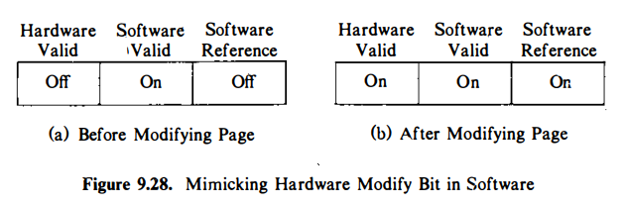
Demand Paging on Less-Sophisticated Hardware

Slide 61
A Hybrid System With Swapping And Demand Paging
Although demand paging systems treat memory more flexibly than Swapping systems, situations can arise where the page stealer and validity fault handler thrash because of a shortage of memory.
If the sum of the working sets of all processes is greater than the physical memory on a machine, the fault handler will usually sleep, because it cannot allocate pages for a process.
The page stealer will not be able to steal pages fast enough, because all pages are in a working set.
System throughput suffers because the kernel spends too much time in overhead, rearranging memory at a frantic pace

Slide 62
A Hybrid System With Swapping And Demand Paging
The System V kernel runs swapping and demand paging algorithms to avoid thrashing problems.
When the kernel cannot allocate pages for a process, it wakes up the swapper and puts the calling process into a state that is the equivalent of “ready to run but swapped”
The swapper swaps out entire processes until available memory exceeds the highwater mark.
For each process swapped out, it makes one "ready-to-run but swapped" process ready to run.
Later iterations of the swapper will allow other processes to be faulted in if there is sufficient memory in the system.
This method slows down the system fault rate and reduces thrashing; it is similar in philosophy to methods used in the VAX/VMS operating system

Slide 63
Reference
The Design of the UNIX Operating System, by Maurice J. Bach

